Slide 1
People‘s Support to the Doi Moi in Vietnam
Matteo Migheli
(University of Torino and CeRP)
Torino, March 13 2015
Campus Luigi Einaudi Lungo Dora Siena 100/A, 10153 Torino, Italy www.est.unito.it

Slide 2
Motivation
Vietnam is an interesting natural case of double transition from a market to a planned economy and the viceversa
Actually the first transition has never been completely accomplished in the South
At the end of the Seventies the Vietnamese Government started a process of economic and social reforms (the Doi Moi) that gained momentum since the mid Eighties
However, reforms, also in non-democratic countries, need the support of the population (Williamson, 1994)
Matteo MIGHELI
Asian emerging economies in the post crisis era

Slide 3
Economic Doi Moi
The Doi Moi has been involving many aspects of the social life in Vietnam
Here I focus on the economic aspects only
In spite of the long time elapsed since the beginning of the process, only some economic sectors have been liberalised so far (rice)
The process has entailed large re-distributions of land, with non-market criteria
BUT: in the South the land had never been fully collectivised
Matteo MIGHELI
Asian emerging economies in the post crisis era

Slide 4
Economic Doi Moi
Boosted private entrepreneurship in the industrial sector
Abolished flat wages
Failed in privatising agriculture in the North (re-institutions of co-operatives in 1998 after abolition in 1986)
Increased the urban-rural dichotomy
Matteo MIGHELI
Asian emerging economies in the post crisis era

Slide 5
Aims
Using micro-data from the World Values Survey this work tries to assess:
Whether people in different jobs are more or less supportive of the process of renovation, since it abolished
Whether an urban-rural divide exists with respect to this support
Whether there are differences between the North and the South
Matteo MIGHELI
Asian emerging economies in the post crisis era

Slide 6
Data
Three waves of the WVS
Repeated cross-sections (i.e. not panel)
Data are collected at provincial level
Important: the current administrative division fully reproduces the division in the two pre-1975 countries
Cleaned data: 2,495 households
I analyse the answers to five questions, which capture the people’s preferences over as many aspects of a market economy
Matteo MIGHELI
Asian emerging economies in the post crisis era

Slide 7
Questions
Now I'd like you to tell me your views on various issues. How would you place your views on this scale? 1 means you agree completely with the statement on the left; 10 means you agree completely with the statement on the right; and if your views fall somewhere in between, you can choose any number in between.
Competition is good. It stimulates people to work hard and develop new ideas vs. Competition is harmful. It brings out the worst in people
Private ownership of business should be increased vs. Government ownership of business should be increased
Incomes should be made more equal vs We need larger income differences as incentives
Matteo MIGHELI
Asian emerging economies in the post crisis era

Slide 8
Methodology
All the dependent variables are discrete, and are therefore analysed by the means of ordered probit regressions
Controls:
Location (province, size of town)
Type of job (unfortunately not very disaggregated)
Age, gender, marital status
Matteo MIGHELI
Asian emerging economies in the post crisis era

Slide 9
Results
Household income is positively related to the support to economic reforms in a market-oriented sense
The data highlight a North-South divide, with the North more supportive of a market-oriented economy than the South
There is some relevant effect of the job on the preferences
Agricultural workers are particularly favourable to a market-oriented economy
Matteo MIGHELI
Asian emerging economies in the post crisis era

Slide 10
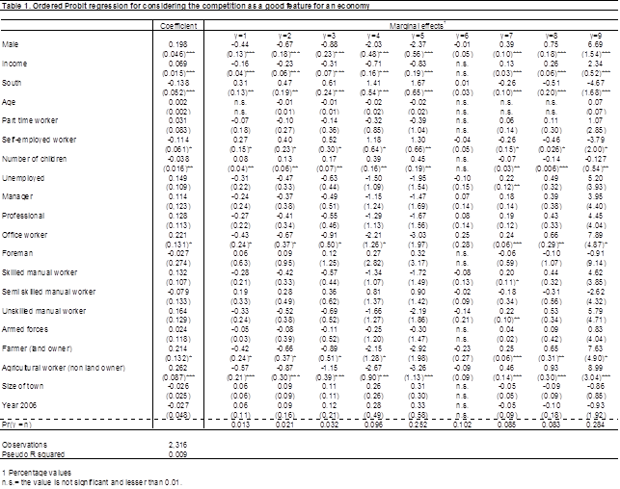
Results

Slide 11
Results

Slide 12
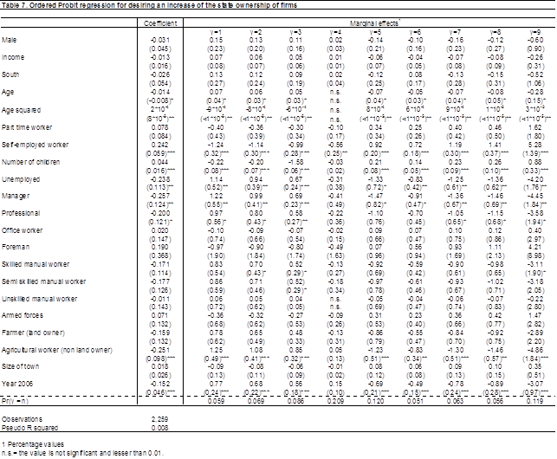
Results

Slide 13
Conclusions
The data reveal the existence of a North-South divide
In particular, southern Vietnamese are less supportive of a market economy than Northern Vietnamese
This may be due to the uneven distribution of the benefits of Doi Moi
I also detect some gender effect (with males more supportive of a M.E. than women), perhaps reflecting the usual gender differences in preferences for competition
Matteo MIGHELI
Asian emerging economies in the post crisis era

