Slide 1
Financing subnational investment for urban green growth in China
Giorgio Brosio
University of Torino
Presentation prepared for the Workshop on
Asian Emerging Economies in the post-crisis era: growth trajectories, challenges and perspectives
Turin, March 12-13 2015

Slide 2
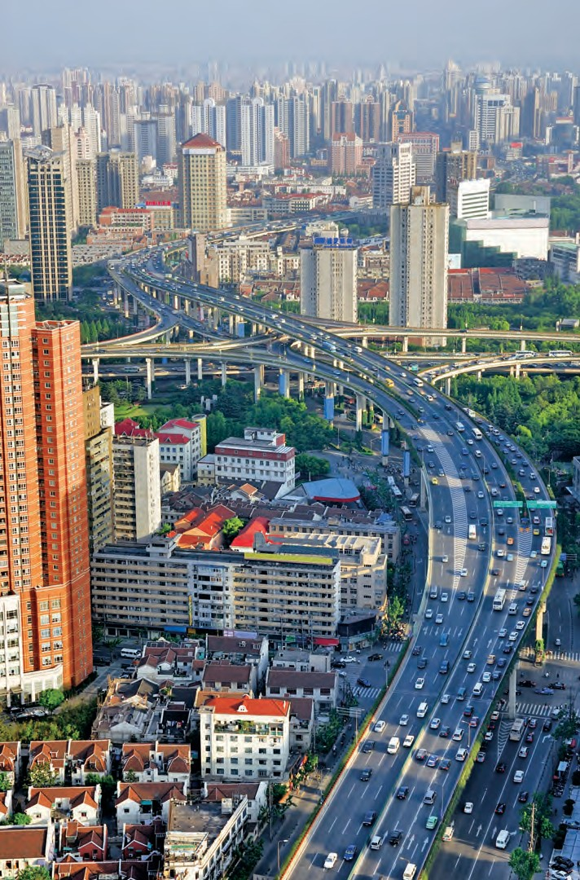

Slide 3
Outline
The present context for financing urban infrastructure in China
Focus on the property tax:
The Marshallian link: investment expands the tax bases providing self financing, with
Exploiting the increase of property values affected by investment.
Prospects for reform.
Congestion taxes: to correct environmental damages and provide multiple sources of revenue (directly and through variation of property values).

Slide 4
Financing urban infrastructure: present context
Local governments responsible for much of infrastructure
China is, on the expenditure side, one of the most decentralized countries of the world (Central Gov. 30%. Subnational Gov. 70%).
Spent since early 1990’s a huge share of GDP on urban infrastructure. However, a lot has to done;
For transport.
For providing education, health and other services to migrant workers.
For improving basic environmental goods (no safe tap water in the cities).
For accommodating further urbanization (China is less urbanized than predicted by its GDP level).

Slide 5
Financing urban infrastructure: present context
Local governments also have few own tax revenue resources and little discretion over tax rates and policy.
Main source of revenue are the land leasing fees, representing one third of total tax revenue (32.5% in2010, against a mere 4.5 percent in 1999).
Huge contraction of land sales appeared in second half of 2014
Taxes on property represent only 15% of total tax revenue, but a with a prevalence of taxes on transaction of properties.

Slide 6
Financing urban infrastructure: present context
Central transfers mainly for current spending, small margin to finance infrastructure.
Extensive use of off-budget mechanisms to finance infrastructure investment, with very little monitoring and central oversight.
Although direct borrowing is forbidden, subnational governments run a deficit estimated to be around 2-3% of GDP.
Borrowing regime being overhauled. Close the back door, open the front door: i.e. allowing local governments to borrow from banks and issuing of bonds.
Borrowing will, however, remain a problem as local governments own banks that in turn subscribe the bonds.

Slide 7
Property taxation in China
Recurrent taxes on property values are marginal because
residential property owned by Chinese is exempt
tax base is not market value, but at best initial value with some adjustments.
tax rates are low.
Consequences
Loss of a huge tax base
Local revenue coming from highly unstable tax bases, such as primarily land leasing fees and taxes on property transactions.

Slide 9
Rationale of property tax: linkages between benefits from expenditure and tax
Investment and policies by local governments impact on values of properties increasing the tax base, meaning
Capitalization of investment expenditure
Example: new underground station.
Households (and firms) located close to the station are ready to pay higher costs for dwellings (with reference to other dwellings located further away).
If demand for property exceeds supply, prices increase, meaning increase of in property values that, when fiscally exploited, provides (part of) the financing.
Exploiting capitalization requires re-assessment of property values.

Slide 10
Tax-benefits linkages at the local level taxes and benefits at the local level
Alfred Marshall. Principles of Economics, 1890
Distinction between onerous rates ad beneficial taxes
Property rates are beneficial, when used to finance services that provide corresponding benefits.
Local governments best positioned to provide beneficial services to their citizens by virtue of their proximity.
National taxes are by necessity onerous: because of the difficulty of establishing a relationship between benefits and costs.

Slide 11
Alfred Marshall on Onerous and Beneficial taxes
“Onerous rates are those which yield no compensating benefit to the persons who pay them. An extreme case is that of rates devoted to paying interest on a loan incurred by a municipality for an enterprise that failed and has been abandoned. Onerous rates tend of course to drive away those persons on whom they would fall.
On the other hand beneficial or remunerative rates are those spent on lighting, draining, and other purposes; so as to supply the people who pay the rates with certain necessaries, comforts and luxuries of life, which can be provided by the local authority more cheaply than in any other way”
"Services which are preponderantly national in character" are "generally onerous"; while "those which are preponderantly local in character generally confer upon rate-payers a direct and peculiar benefit more or less commensurate with the burden”.

Slide 12
Expanding the role of property taxation in China
While the role of a fully-fledged property tax is crucial for the development of an urban strategy underpinning sustainable growth.
Challenges of design and implementation are formidable, because of
insufficient definition of property rights;
popular opposition no tax has been paid on residential property since 1949, while acquisition of first, second and third property is a widespread form of saving
Assessment of values is still problematic.

Slide 13
Expanding the role of property taxation in China
An English “Community Charge” type property tax, where the tax is paid by the occupant of the dwelling and linked to benefits received,
Would suit China , where property rights are not yet well defined.
Could offset the problems with the Shanghai and Chongqing experiments
Would reduce the number of vacant (here owner pays tax) properties, easing rents and dampening increase of property prices.
Properly defined property taxation also facilitates access to credit needed to finance a sustainable urbanization strategy.
Taxation of built-up land has historically been the backbone of local taxation in advanced countries, and its importance has grown with urbanization.

Slide 14
Expanding the role of property taxation in China: prospects for reform
People’s Daily announced last August the country is likely to introduce a nationwide property tax as early as next year (2015).
The lack of a proper registration database is one reason it may take some time.
The lack of national standards on basic information, like who owns which property, is also an obstacle that will likely take some time to resolve.
Second and third houses are a common destination of almost untaxed savings.

Slide 15
Expanding the role of property taxation in China: pilot experiments
Early 2011 Shanghai started to tax newly purchased second homes of residents and first homes of nonresidents on the basis of the market value, with the exclusion from the tax base of 60 square meters per person.
Chongqing is targeting the existing single-family residences and newly purchased luxury apartments of residents, or newly purchased second homes of nonresidents. The program excludes 180 square meters for the single-family residences and 100 square meters for apartments in Chongqing.
Only about 8,000 parcels are reported to have levied a property tax in these two cities combined.

Slide 16
Congestion and distance related taxes
Suggested by an increasing literature and sponsored by governments,, particularly in the Scandinavian countries.
A still limited number of cases of implementation: London, Milan and Singapore, where a congestion fee is applied to vehicles passing through cordons that identify central and congested areas.
Considered with increased interest in Chinese cities, overwhelmed by staggering increase of vehicles in urban centers.

Slide 17
Congestion and distance related taxes
Supplement national fuel taxes with local instruments impacting on urban planning.
Also supplement funds for sustainable growth infrastructure.
Use of new technologies – GPS and electronic gates – makes congestions taxes accessible.
Scale the burden according to the different spatial incidence of damage: urban versus rural areas.

Slide 18
Congestion and distance related taxes: correcting and revenue impact
Correct, i.e. internalize polluting impact and other (accidents) damages, from vehicle use in congested areas.
Provide direct and substantial revenue to urban governments.
Also have a potential for increasing the revenue from property tax.
Reduced congestion leads to increased residential property values in (former) congested area, likely to outweigh reduction of values in other areas.
Leading to increased collections with frequent re-assessment of property values.

Slide 19
Policy options for China
Expanding subnational own taxes in China is essential to provide a permanent source of finance for green and social investment and to increase accountability.
Taxation at the local level magnifies the link between the benefits of the expenditure and the tax burden.
A panoply of instruments is available, whose concomitant use allows reaching of revenue (and environmental) targets.
At the municipal/county level
Community charge (variant of property tax) linked to services,
Congestion taxes and fees.

